Slide 1

STUDENT SUCCESS:
WHAT MATTERS?
Marco Cordero, Avery Fulton,
Greyson Hall, Prue Whaley
University of Colorado - Boulder | 2024

Slide 2
OVERVIEW
Introduction
Exploration
Data Overview
Analysis
Problem Statement
Results
Methodology
Conclusion
University of Colorado - Boulder | 2024
Department of Applied Math

Slide 3
DATA OVERVIEW
17,349 Students
254 Indicators
10 Years
University of Colorado - Boulder | 2024
Department of Applied Math

Slide 4
PROBLEM STATEMENT
Investigation of pre-admission factors that are predictive of increased major retention rate and/or overall GPA in the College of Engineering.
University of Colorado - Boulder | 2024
Department of Applied Math

Slide 5
OBJECTIVES
Objective 1
Objective 2
Clean, parse, and develop segmentations within the data to group students into similar cohorts
Find objective measures of student success for each group & identify crucial factors to maximize success
University of Colorado - Boulder | 2024
Department of Applied Math

Slide 6
METHODOLOGY
1) Cohort Design
2) Data Encoding
Split the data into 4 groups based on education timeline and transfer status
Split the data into 4 groups based on education timeline and transfer status
University of Colorado - Boulder | 2024
Department of Applied Math
3) Feature Selection
4) Predictive Modeling
Utilize Random Forest model to identify the top 10 most influential features
Use Logistic Regression to predict student success

Slide 7
Cohort Design
Pre-COVID Freshmen
Pre-COVID Transfers
Post-COVID Freshmen
Post-COVID Transfers
Department of Applied Math
University of Colorado - Boulder | 2024

Slide 8
Data Encoding
15 Newly Created Features
Department of Applied Math
University of Colorado - Boulder | 2024

Slide 9
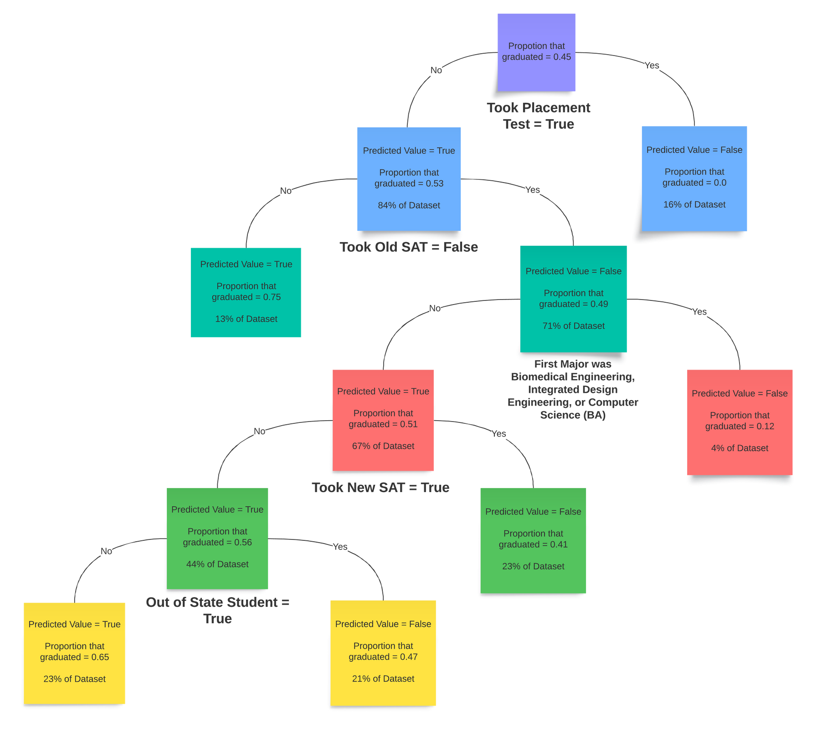
Feature Selection: Decision Trees
Department of Applied Math
University of Colorado - Boulder | 2024

Slide 10
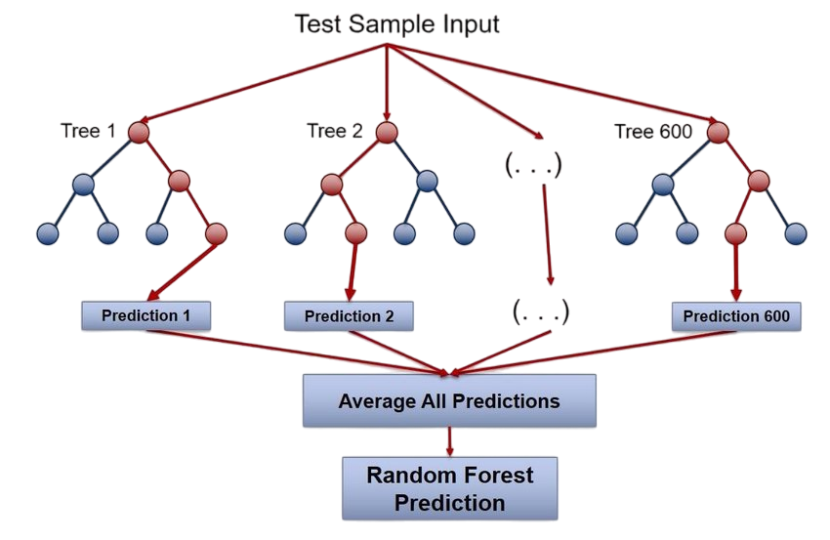
Feature Selection: Random Forest
Department of Applied Math
University of Colorado - Boulder | 2024

Slide 11
Predictive Linear Modeling
Department of Applied Math
University of Colorado - Boulder | 2024

Slide 12
ANALYSIS
In all cases except pre-COVID transfer students, the most predictive factors for student success are the same:
First_EN_Major
TransferHrs
cc_hsgpa
Department of Applied Math
University of Colorado - Boulder | 2024

Slide 13
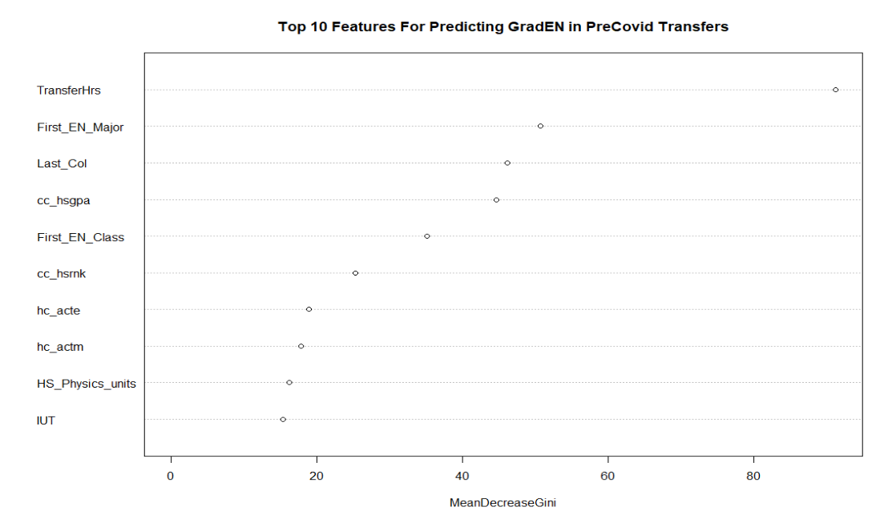
ANALYSIS
Department of Applied Math
University of Colorado - Boulder | 2024

Slide 14
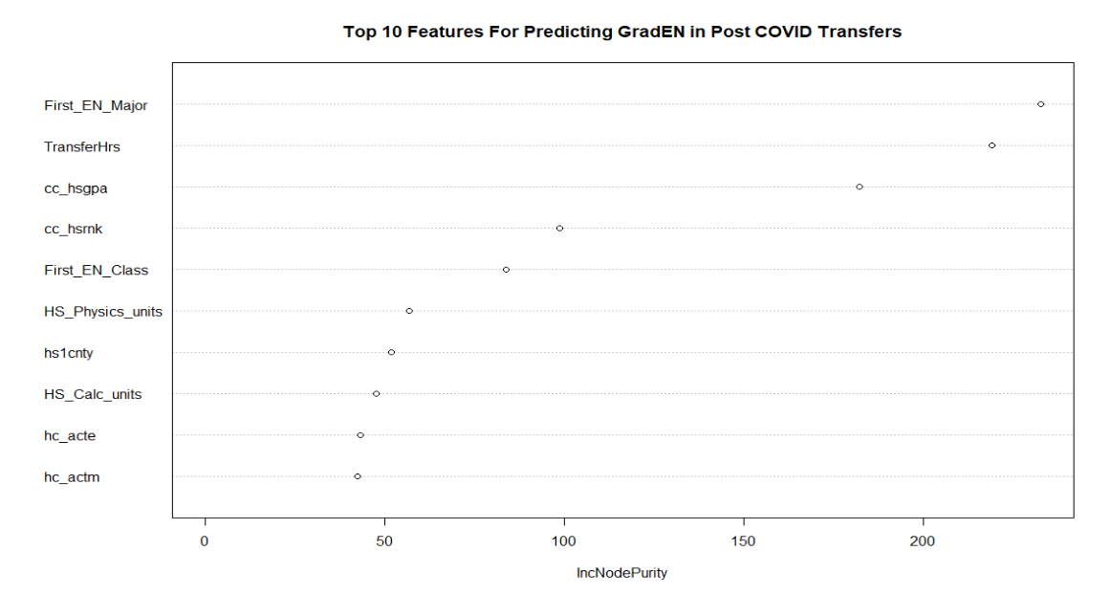
ANALYSIS
Department of Applied Math
University of Colorado - Boulder | 2024

Slide 15
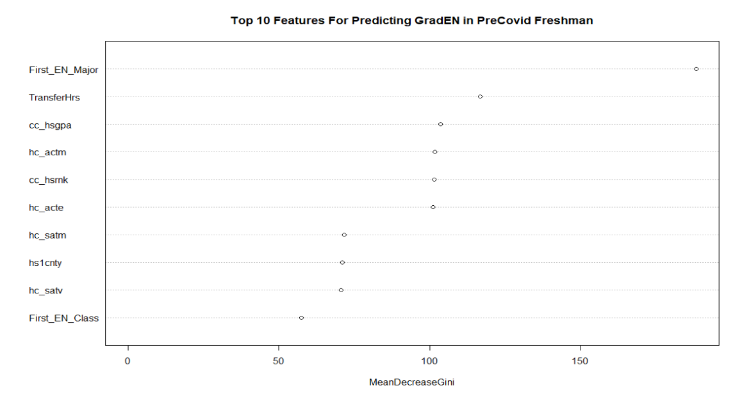
ANALYSIS
Department of Applied Math
University of Colorado - Boulder | 2024

Slide 16
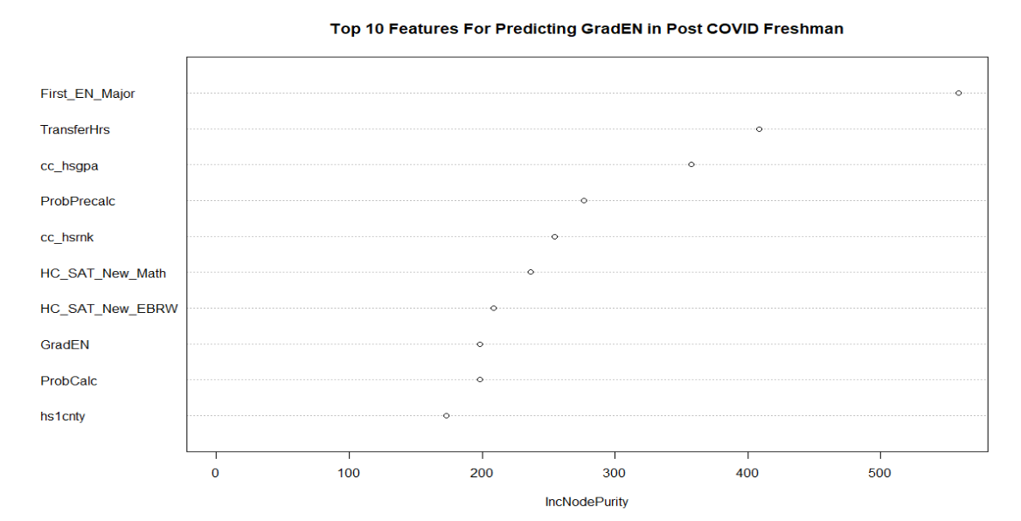
ANALYSIS
Department of Applied Math
University of Colorado - Boulder | 2024

Slide 17
CONCLUSION
Similar Results for Each Cohort
Inconsistent Policies/Dataset
Supports previous results/research
University of Colorado - Boulder | 2024
Department of Applied Math

Slide 18
University of Colorado - Boulder | 2024
Department of Applied Math
QUESTIONS?

